Slide 1


Overview of Research at the IDIR Lab
Chengkai Li
Associate Professor, Department of Computer Science and Engineering
Director, Innovative Database and Information Systems Research (IDIR) Laboratory
University of Texas at Arlington
August 23, 2017
https://idir.uta.edu

Slide 2
Research at the Innovative Database and Information Systems Research Laboratory (IDIR)
Research areas
Big Data and Data Science (Database, Data Mining, Natural Language Processing)
Theme of current research
building large-scale human-assisting and human-assisted data and information systems with high usability, low cost and applications for social good
Research directions
computational journalism, computational fact-checking
crowdsourcing and human computation
cybersecurity, social bots
data exploration by ranking/skyline/preference queries
graph database usability, knowledge graphs

Slide 3

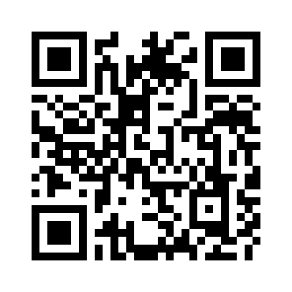
Toward the Holy Grail of Automated Fact-checking
idir.uta.edu/claimbuster

Slide 4
Politicians Make False and Misleading Claims
Fact-checks on major party presidential nominees.
Source: PolitiFact.com

Slide 5
National Security Threats
Fake-news floods social media (“filter bubbles” and “echo chambers”).
Facebook trend topic algorithms promoted fake-news.
A sample of 140,000 Twitter users in the battleground state of Michigan shared as many junk news items as professional news during the final ten days of the 2016 election. http://politicalbots.org/?p=1064
Russian government interfered with the 2016 election. Fake-news websites and bots used.
Pizzagate: conspiracy theory led to shooting

Slide 6
Combating Falsehoods
100+ active fact-checking sites in 2017 (PolitiFact.com, FullFact.org, CNN, Washington Post, New York Times, …)
Google and Bing include fact-checks in search results.
Facebook lets users report false items and flags items disputed by fact-checkers.

Slide 7
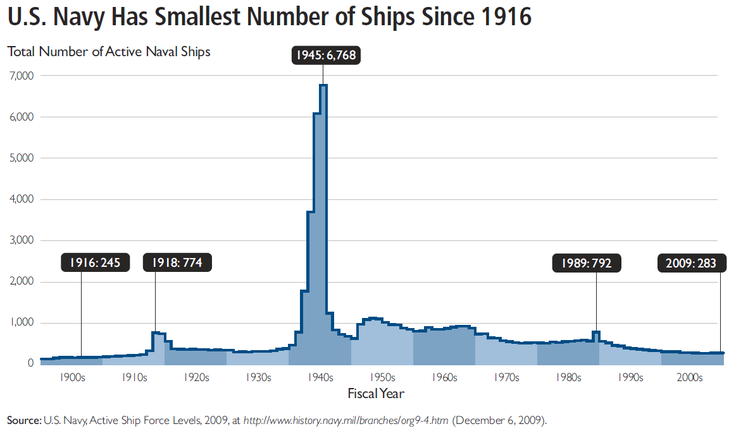
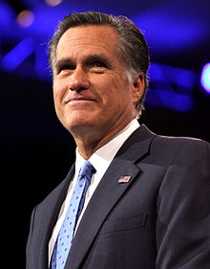
Fact-checking is Hard
“… our Navy is smaller than it's been since 1917", said Republican candidate Mitt Romney in third presidential debate in 2012.
http://en.wikipedia.org/wiki/Mitt_Romney
http://s3.amazonaws.com/thf_media/2010/pdf/Military_chartbook.pdf

Slide 8

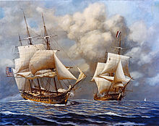
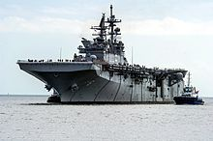
Fact-checking is Hard
“… our Navy is smaller than it's been since 1917", said Republican candidate Mitt Romney in third presidential debate in 2012.
vs
http://en.wikipedia.org/wiki/Mitt_Romney
http://s3.amazonaws.com/thf_media/2010/pdf/Military_chartbook.pdf
http://en.wikipedia.org/wiki/United_States_Navy

Slide 9
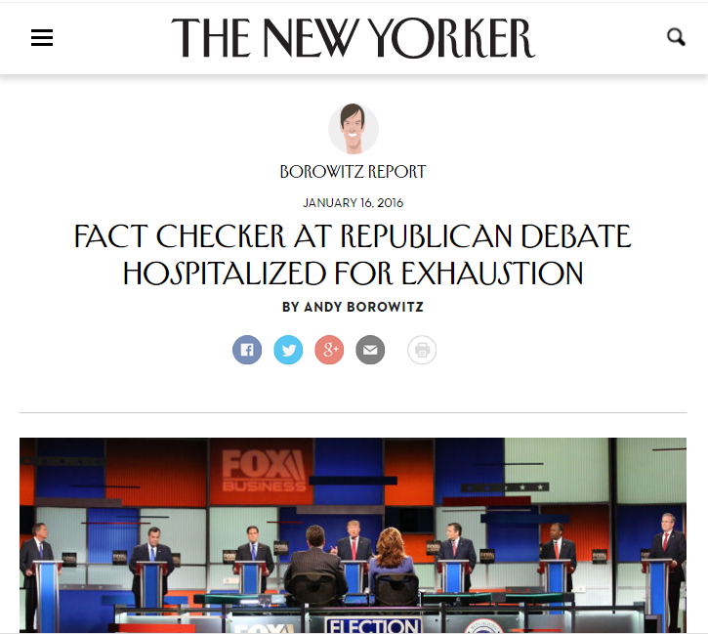
Demanding Task vs. Lack of Automated Tools
satire

Slide 10
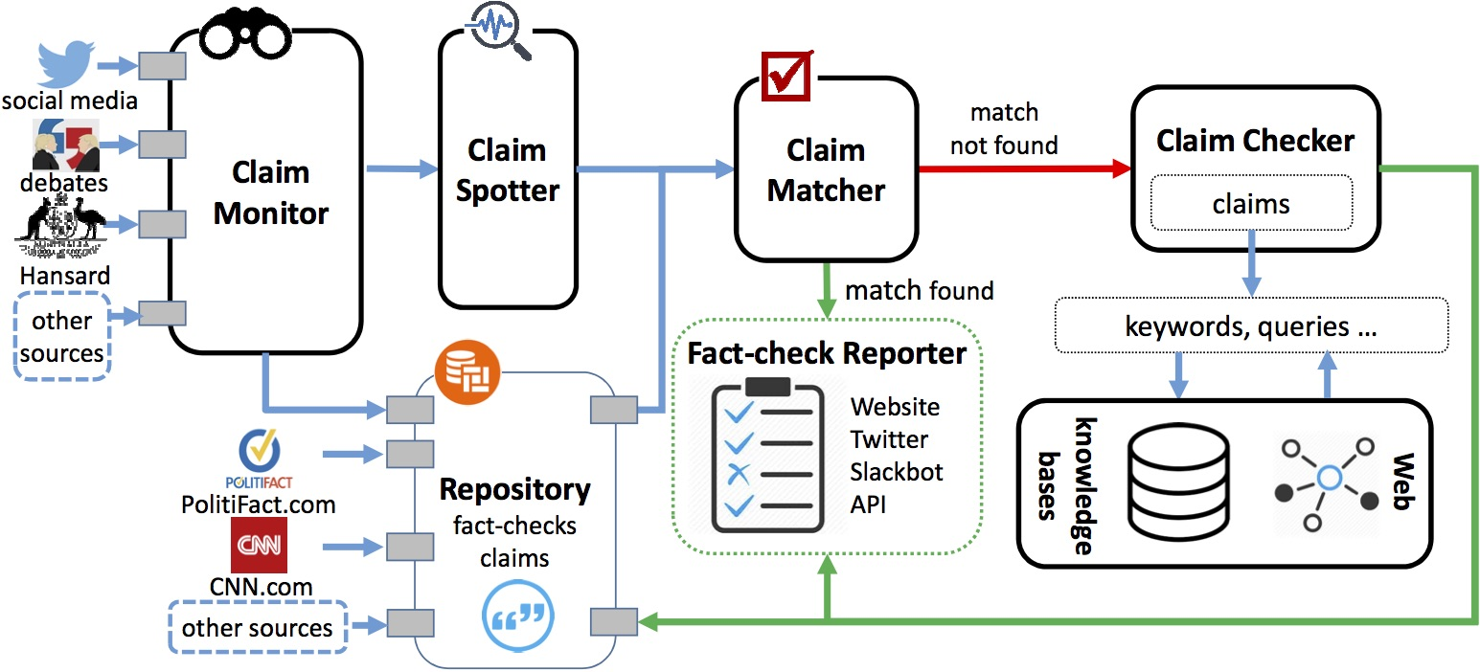


Botminator: Automated Detection of Fake-news Bots
Objective
discover social bots that publish and spread fake news
Recently funded by the Texas National Security Network
Interdisciplinary Approach
Social network, graph, and text mining
Code analysis
News content and effect analysis
Collaborators on the Team
Christoph Csallner (CSE, UTA)
Mark Tremayne (Communication, UTA)
Angela Lee (Emerging Media and Communication, UTD)
Zhiqiang Lin (CS, UTD)

Slide 11
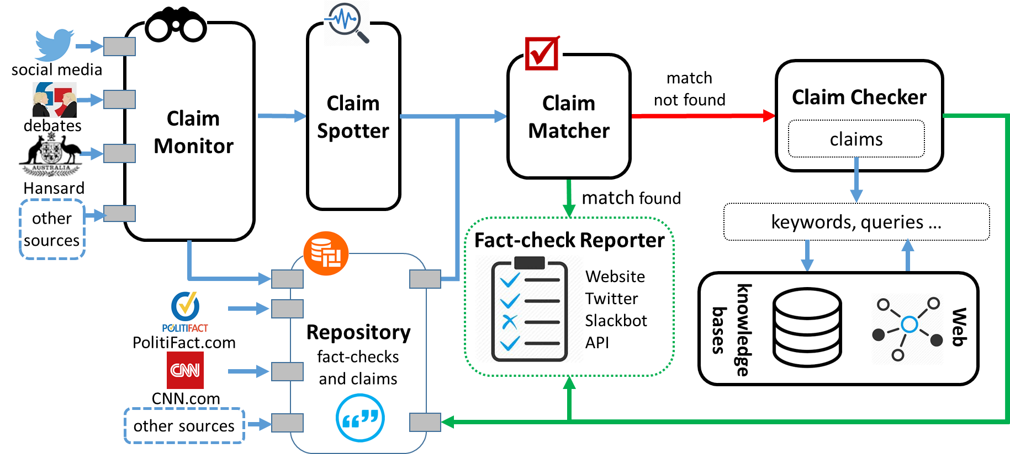
ClaimBuster: The First-ever End-to-end System

Slide 12
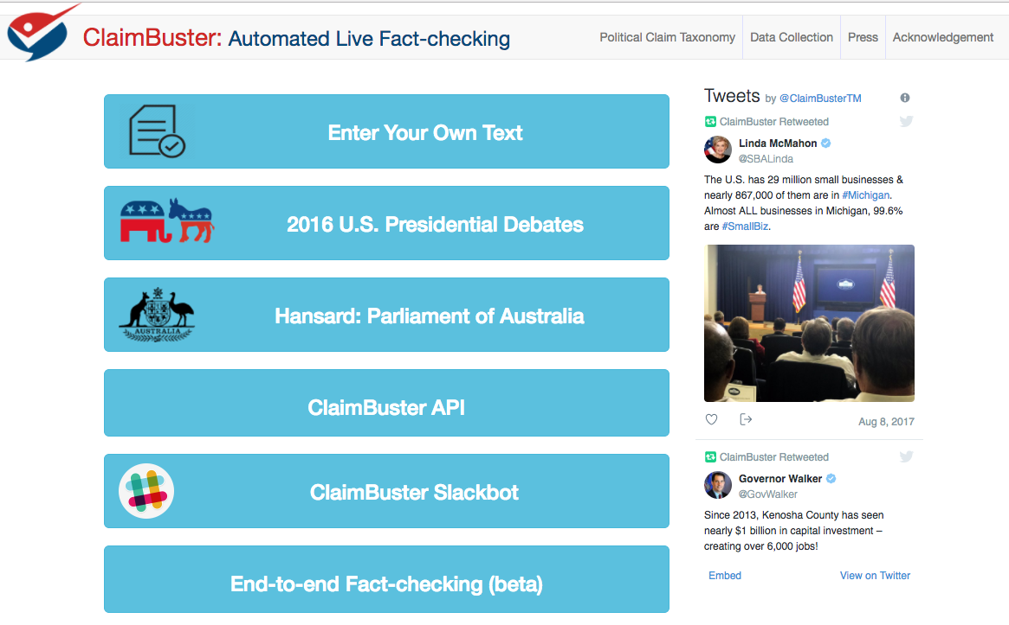

Slide 13
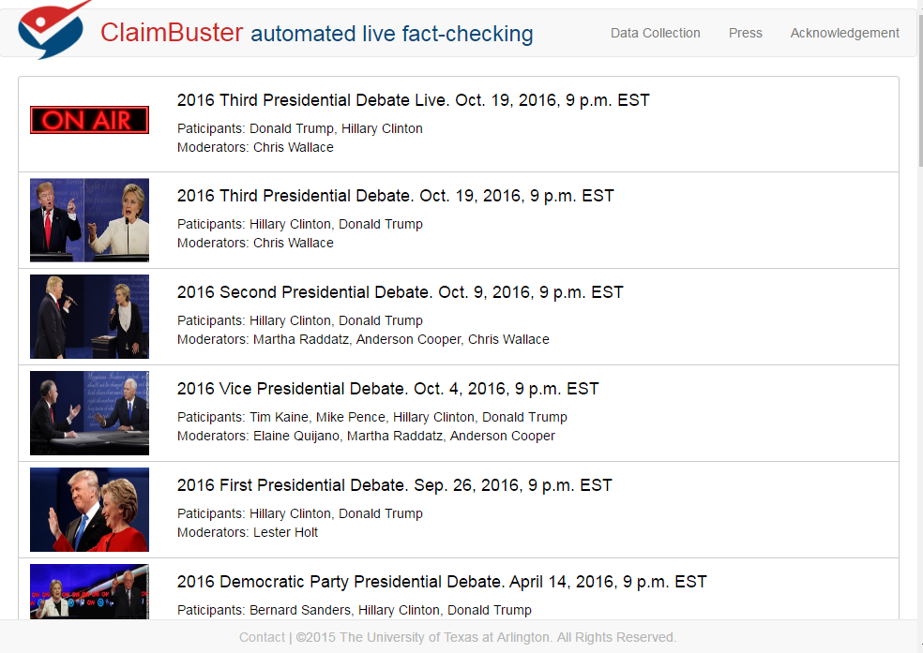

Slide 14
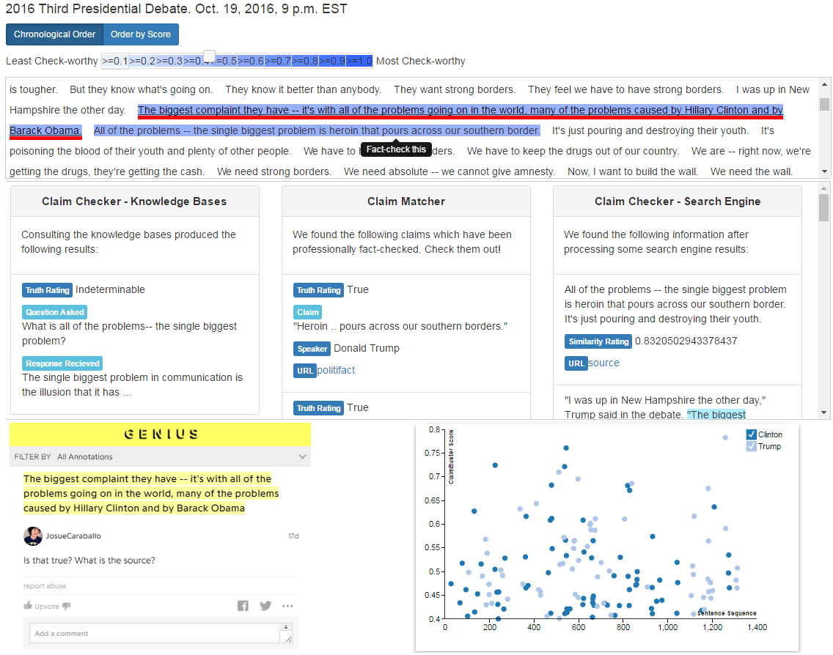

Slide 16

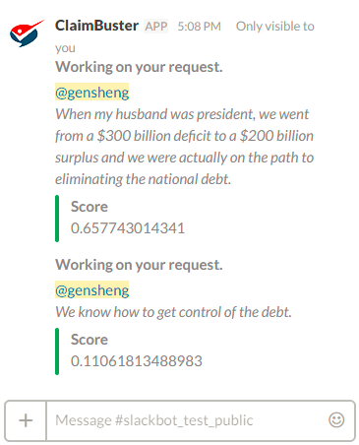
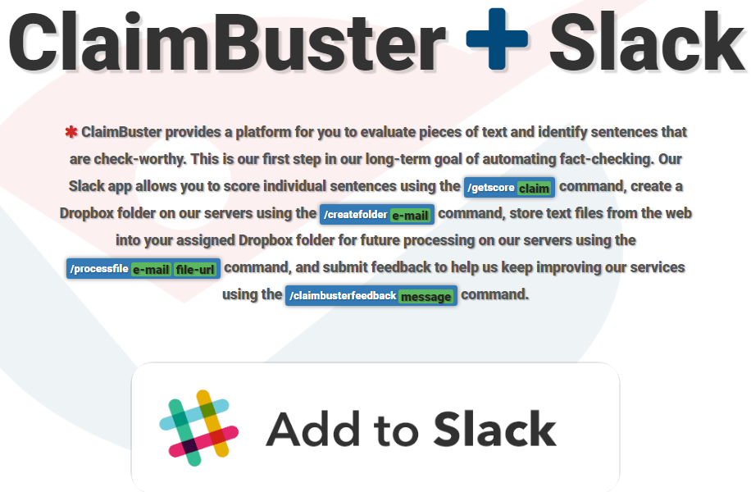

Slide 17


In the Press
System idir.uta.edu/claimbuster
System idir.uta.edu/claimbuster

Slide 18
Collaborators
Current/Former UTA Students
Naeemul Hassan
Gensheng Zhang
Fatma Arslan
Josue Caraballo
Damian Jimenez
Siddhantsanjeev Gawsane
Shohedul Hasan
Minumol Joseph
Aaditya Kulkarni
Anil Kumar Nayak
Vikas Sable
Collaborators
Bill Adair (Duke)
Pankaj Agarwal (Duke)
Christoph Csallner (UTA)
Peter Frays (University of Technology Sydney)
James Hamilton (Stanford)
Angela Lee (UTD)
Zhiqiang Lin (UTD)
Mark Tremayne (UTA)
You Wu (Google)
Jun Yang (Duke)
Cong Yu (Google)

Slide 19

Funding Sponsors
NSF #1719054
New Knight Grant
Texas National Security Network Excellence Fund
NSF #1565699 (I-Corps Teams)
Knight Prototype Fund
NSF #1408928

Slide 20





Finding Important Factual Claims:
A Supervised Learning Task
2016
Presidential
Debates
Human Annotation
Feature Extraction
Learning Algorithm
Ground Truth
Feature Vectors
Presidential Debate Transcripts (1960-2012)
Important factual claims

Slide 21
Classification and Ranking by Check-worthiness
CFS: Important factual claims
“We spend less on the military today than at any time in our history.” “The President’s position on gay marriage has changed.” “More people are unemployed today than four years ago.”
UFS: Unimportant factual claims
“I was in Iowa yesterday.” “My mother enjoys cooking.” “I ran for President once before.”
NFS: No factual claims (opinions, questions & declarations)
“Iran must not get nuclear weapons.” “7% unemployment is too high.” “My opponent is wishy-washy.” “I will be tough on crime.” "Why should we do that?“ “Hello, New Hampshire!” “Our plan is to reduce tax rate by 10%.”

Slide 22
Feature Extraction
Word:
state, legislature, 87, percent, democrat
Sentiment: 0.032
I was in a state where my legislature was 87 percent Democrat.
Part-of-Speech:
Noun
Entity Type:
Quantity
Concept:
United States
Sentiment: [-1.0 to 1.0]
Word: tf-idf scores of 6130 words (excluding rare words)
POS Tag: 43 tags
Entity Type: 26 types

Slide 23
Feature Importance
6615 features in total
Used a Random Forest Classifier to calculate the importance of each feature.
Word | percent; people; jobs
POS Tag | noun; cardinal number; past tense; preposition
Entity Type | Quantity; Country; FieldTerminology; Person
Concept | United States Senate; Barack Obama
Sentiment

Slide 24
Our Own CrowdFlower

Slide 25
Coder Quality

Slide 26
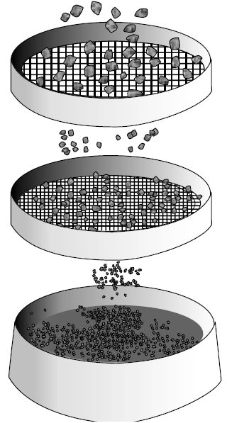
Ground Truth Collection
20788 sentences
374 coders
76552 labels
20788 sentences
20 months, 374 coders, ~$4,000 paid
30 training sentences
1032 screening sentences (731 NFS, 63 UFS, 238 CFS) to detect spammers & low-quality coders
86 top-quality coders
52333 labels
Class | Count | Percentage
CFS | 4849 | 23.52%
UFS | 2097 | 10.17%
NFS | 13671 | 66.31%
Majority voting
20617 admitted sentences
http://www.engineersdaily.com/2014/03/basics-of-soil-compaction.html

Slide 27
Case Study: 2016 U.S. Presidential Election Debates

Slide 28

Other Projects and Demos
Demonstration Videos https://vimeo.com/channels/1024406
ClaimBuster (idir.uta.edu/claimbuster) Automated, Live Fact-Checking
CrewScout (idir.uta.edu/crewscout) Expert Team Finding by Skyline Groups
ERQ: Entity-Relationship Query (idir.uta.edu/erq) Structured Entity-Centric Query on Wikipedia
Facetedpedia (idir.uta.edu/facetedpedia) Faceted search interface for Wikipedia
FactWatcher (idir.uta.edu/factwatcher) Automated Monitoring of Facts from Real-World Events
GQBE (idir.uta.edu/gqbe) Graph Query by Example
Orion (idir.uta.edu/orion) Auto-suggestion for Interactive Graph Query Formulation
TableView Generating Preview Tables for Knowledge Graphs
28
System idir.uta.edu/claimbuster
System idir.uta.edu/claimbuster

Slide 29
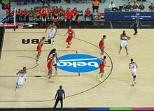
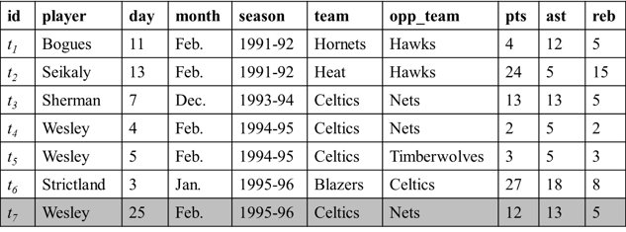
FactWatcher: Story-finding
Finding and monitoring number-based facts pertinent to real-world events. The facts are leads to news stories.
New tuple appended to database
Real-world event (sports, transportation, crime, weather, finance, social media)
Wesley had 12 points, 13 assists and 5 rebounds on February 25, 1996 to become the first player with a 12/13/5 (points/assists/rebounds) in February.
Find facts
Generate factual claim
http://en.wikipedia.org/wiki/Basketball

Slide 30
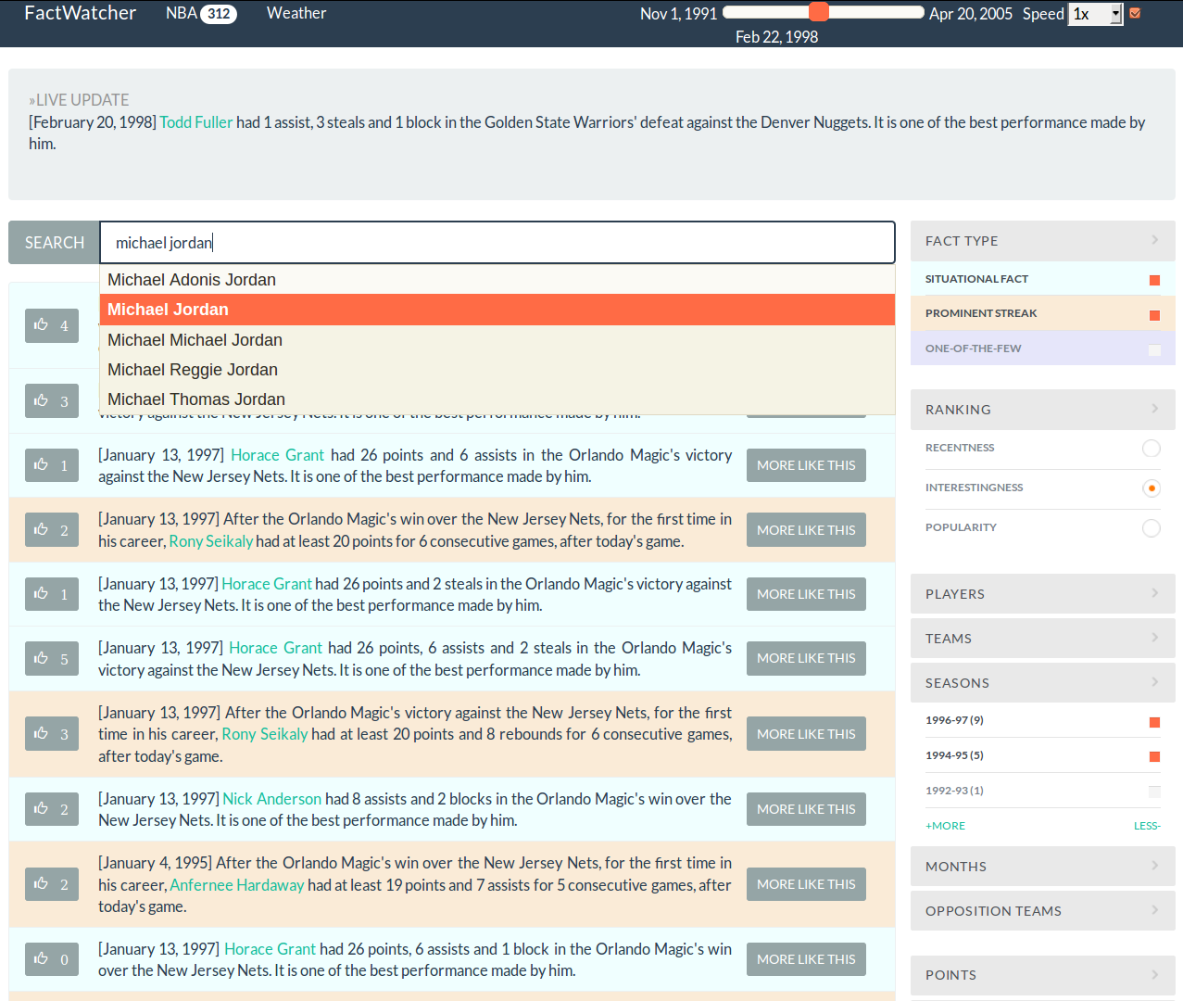

FactWatcher
idir.uta.edu/factwatcher
Excellent Demo Award

Slide 31
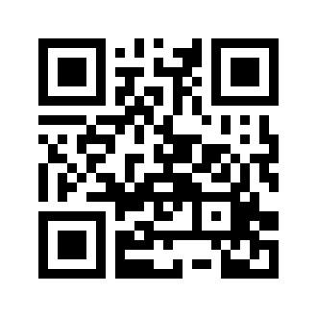

Orion
Prototype
http://idir.uta.edu/orion
Introduction Video
http://bit.ly/1O0GnNo

Slide 32
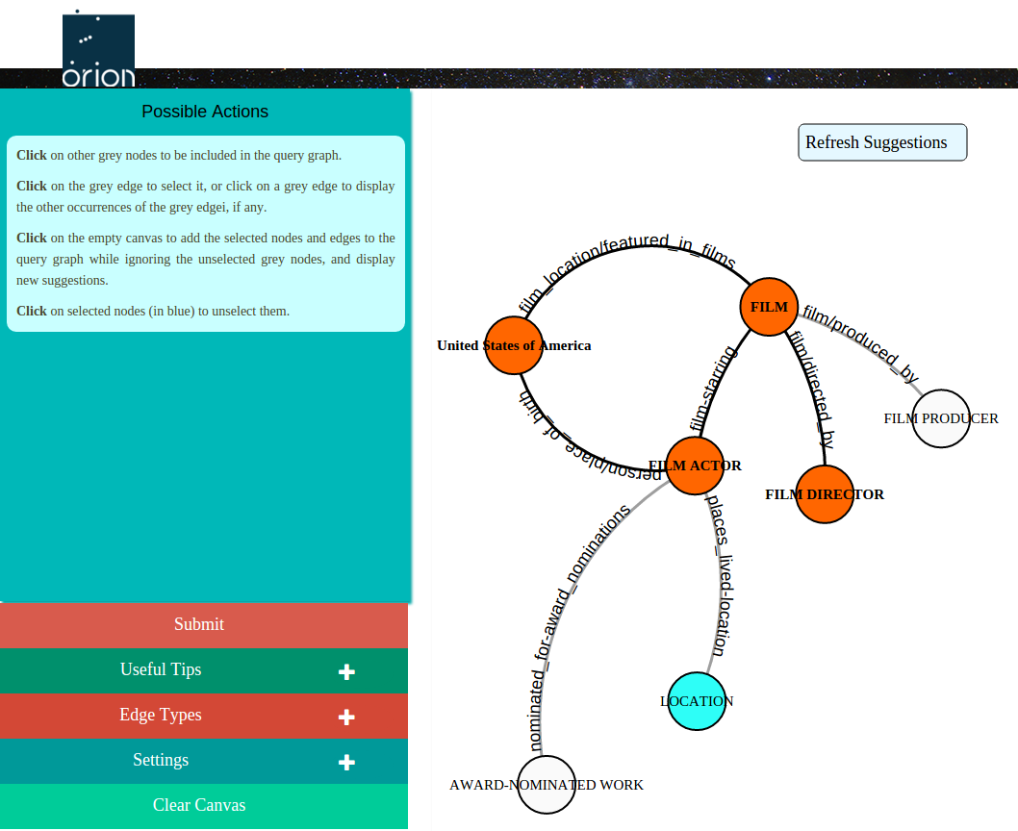
Orion GUI
Dynamic list of all possible user actions at any given moment
Control panel for various settings and tips

Slide 33
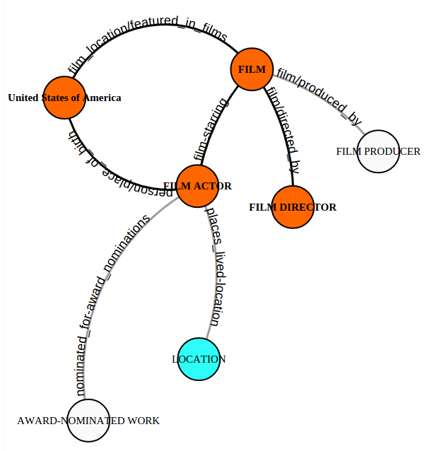
Active Mode
Grey edges and nodes automatically suggested in active mode:
Accepted by user (blue): positive edges
Ignored by user: negative edges

Slide 34
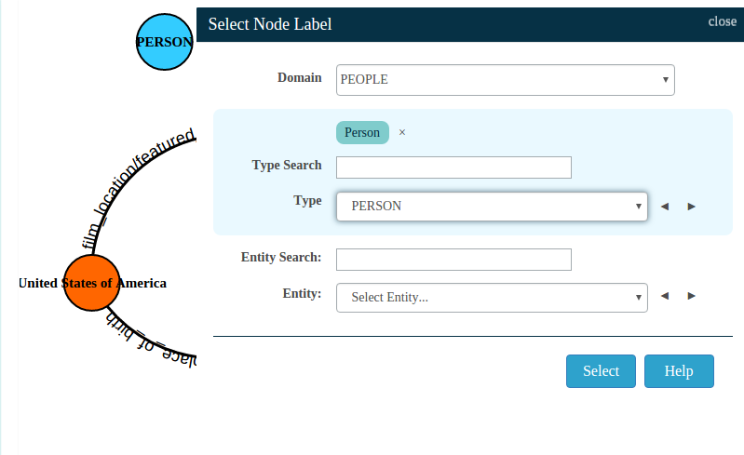
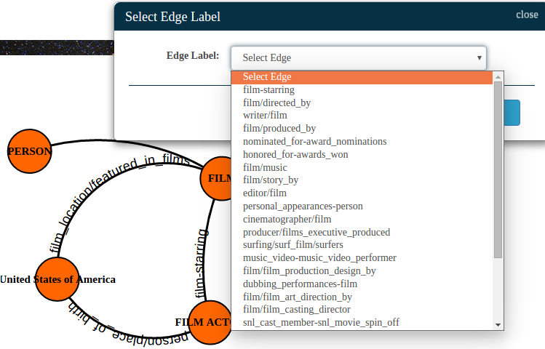
Passive Mode
A new edge added in passive mode
A new node added in passive mode

Slide 35
Publications
Cross-lingual Entity Alignment via Joint Attribute-Preserving Embedding. Zequn Sun, Wei Hu, and Chengkai Li. ISWC 2017.
ClaimBuster: The First-ever End-to-end Fact-checking System. Naeemul Hassan, Gensheng Zhang, Fatma Arslan, Josue Caraballo, Damian Jimenez, Siddhant Gawsane, Shohedul Hasan, Minumol Joseph, Aaditya Kulkarni, Anil Kumar Nayak, Vikas Sable, Chengkai Li, and Mark Tremayne. VLDB 2017, 1945-1948. Demonstration description.
Toward Automated Fact-Checking: Detecting Check-worthy Factual Claims by ClaimBuster. Naeemul Hassan, Fatma Arslan, Chengkai Li, and Mark Tremayne. KDD 2017, pages 1803-1812.
Computational Fact Checking through Query Perturbations. You Wu, Pankaj K. Agarwal, Chengkai Li, Jun Yang, Cong Yu. TODS, 42(1): 4:1-4:41, 2017.
Graph Querying Meets HCI: State of the Art and Future Directions. Sourav S. Bhowmick, Byron Choi, Chengkai Li. SIGMOD 2017, 1731-1736. Tutorial.
Querying knowledge Graphs By Example entity tuples. Nandish Jayaram, Arijit Khan, Chengkai Li, Xifeng Yan, Ramez Elmasri. ICDE 2016: 1494-1495.

Slide 36
Publications (cont’d)
Comparing Automated Factual Claim Detection Against Judgments of Journalism Organizations. Naeemul Hassan, Mark Tremayne, Fatma Arslan, and Chengkai Li. 2016 Computation+Journalism Symposium.
Generating Preview Tables for Entity Graphs. Ning Yan, Sona Hasani, Abolfazl Asudeh, Chengkai Li. SIGMOD 2016: 1797-1811. (Most Reproducible Paper Award)
Detecting Check-worthy Factual Claims in Presidential Debates. Naeemul Hassan, Chengkai Li, Mark Tremayne. CIKM 2015, pages 1835-1838.
Crowdsourcing Pareto-Optimal Object Finding by Pairwise Comparisons. Abolfazl Asudeh, Gensheng Zhang, Naeemul Hassan, Chengkai Li, and Gergely Zaruba. CIKM 2015, pages 753-762.
The Quest to Automate Fact-Checking. Naeemul Hassan, Bill Adair, James Hamilton, Chengkai Li, Mark Tremayne, Jun Yang and Cong Yu. 2015 Computation+Journalism Symposium.
Online Frequent Episode Mining. Xiang Ao, Ping Luo, Chengkai Li, Fuzhen Zhuang, and Qing He. ICDE 2015, pages 891-902.

Slide 37
Publications (cont’d)
VIIQ: Auto-Suggestion Enabled Visual Interface for Interactive Graph Query Formulation. Nandish Jayaram, Sidharth Goyal, Chengkai Li. PVLDB, 8(12): 1940-1943, August 2015. Demonstration description.
Querying knowledge graphs by example entity tuples. Nandish Jayaram, Arijit Khan, Chengkai Li, Xifeng Yan, Ramez Elmasri. TKDE, 27(10): 2797-2811, October 2015.
GQBE: Querying knowledge graphs by example entity tuples. Nandish Jayaram, Mahesh Gupta, Arijit Khan, Chengkai Li, Xifeng Yan, Ramez Elmasri. ICDE, pages 1250-1253, 2014. Demonstration description.
Data In, Fact Out: Automated Monitoring of Facts by FactWatcher. Naeemul Hassan, Afroza Sultana, You Wu, Gensheng Zhang, Chengkai Li, Jun Yang, and Cong Yu. VLDB 2014, pages 1557-1560. Demonstration description. (excellent demonstration award)
Finding, Monitoring, and Checking Claims Computationally Based on Structured Data. Brett Walenz, You (Will) Wu, Seokhyun (Alex) Song, Emre Sonmez, Eric Wu, Kevin Wu, Pankaj K. Agarwal, Jun Yang, Naeemul Hassan, Afroza Sultana, Gensheng Zhang, Chengkai Li, Cong Yu. 2014 Computation+Journalism Symposium.

Slide 38
Publications (cont’d)
Toward Computational Fact-Checking. You Wu, Pankaj K. Agarwal, Chengkai Li, Jun Yang, Cong Yu. VLDB 2014, pages 589-600.
iCheck: computationally combating "lies, d-ned lies, and statistics". You Wu, Brett Walenz, Peggy Li, Andrew Shim, Emre Sonmez, Pankaj K. Agarwal, Chengkai Li, Jun Yang, Cong Yu. SIGMOD 2014, pages 1063-1066.
Incremental Discovery of Prominent Situational Facts. Afroza Sultana, Naeemul Hassan, Chengkai Li, Jun Yang, Cong Yu. ICDE 2014, pages 112-123.
Discovering General Prominent Streaks in Sequence Data. Gensheng Zhang, Xiao Jiang, Ping Luo, Min Wang, Chengkai Li. ACM TKDD, 8(2):article 9, June 2014.
Discovering and Learning Sensational Episodes of News Events. Xiang Ao, Ping Luo, Chengkai Li, Fuzhen Zhuang, Qing He, and Zhongzhi Shi. WWW 2014, pages 217-218.
On "One of the Few" Objects. You Wu, Pankaj K. Agarwal, Chengkai Li, Jun Yang, Cong Yu. KDD 2012, pages 1487-1495.

Slide 39
Publications (cont’d)
Prominent Streak Discovery in Sequence Data. Xiao Jiang, Chengkai Li, Ping Luo, Min Wang, Yong Yu. KDD 2011, pages 1280-1288.
Computational Journalism: A Call to Arms to Database Researchers. Sarah Cohen, Chengkai Li, Jun Yang, Cong Yu. CIDR 2011, pages 148-151. (3rd place in best Outrageous Ideas and Vision (OIV) Track paper competition)

